Slide 1
NETFLIX CLONE REACT APP
A Web Development Project
Presented by:
Akhil Baby - 2347205
Amar G Nath - 2347208
Vishnu Swaroop P S - 2347265
Evaluated By:
Dr.Cynthia

Slide 2
ABSTRACT
Our Netflix Clone React App is a web development showcase that replicates the Netflix experience.
This project highlights the technology stack, hardware and software requirements, and challenges faced during development.With modules for user authentication, a movie catalog, video streaming, and user profiles, we provide an overview of modern web development techniques.
This presentation offers insights into the complexities of building a React-based app and serves as a valuable resource for web development enthusiasts, demonstrating practical skills and inspiring new projects in the digital streaming space.

Slide 3
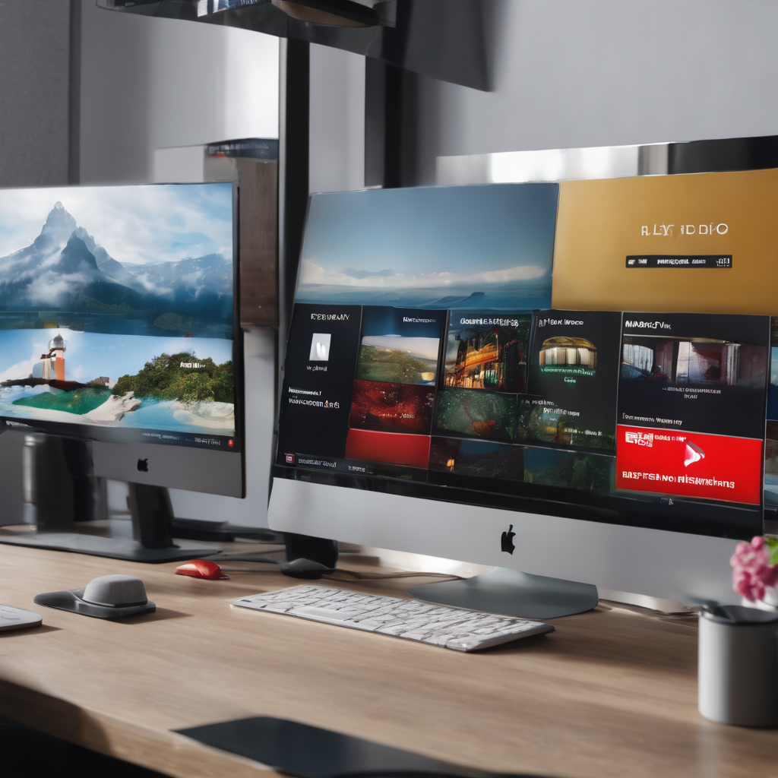
CONTENTS
Introduction
Hardware Requirements
Software Requirements
Project Description
Conclusion
ScreenShots

Slide 4
INTRODUCTION
Introducing the Netflix Clone Project, a web application that brings the world of streaming entertainment to your fingertips. Built on the power of React, this platform is your gateway to a world of cinematic wonders.
Explore a user-friendly experience with smooth animations that guide your journey. The login page ensures a personalized interaction, and the "Netflix" section is your portal to a vast library of content, all seamlessly integrated with video APIs.
Manage your user preferences effortlessly with features like "Logout" and "Create User," all backed by Firebase's robust database. Join us as we embark on a journey into the next level of entertainment technology. Welcome to the Netflix Clone Project.

Slide 5
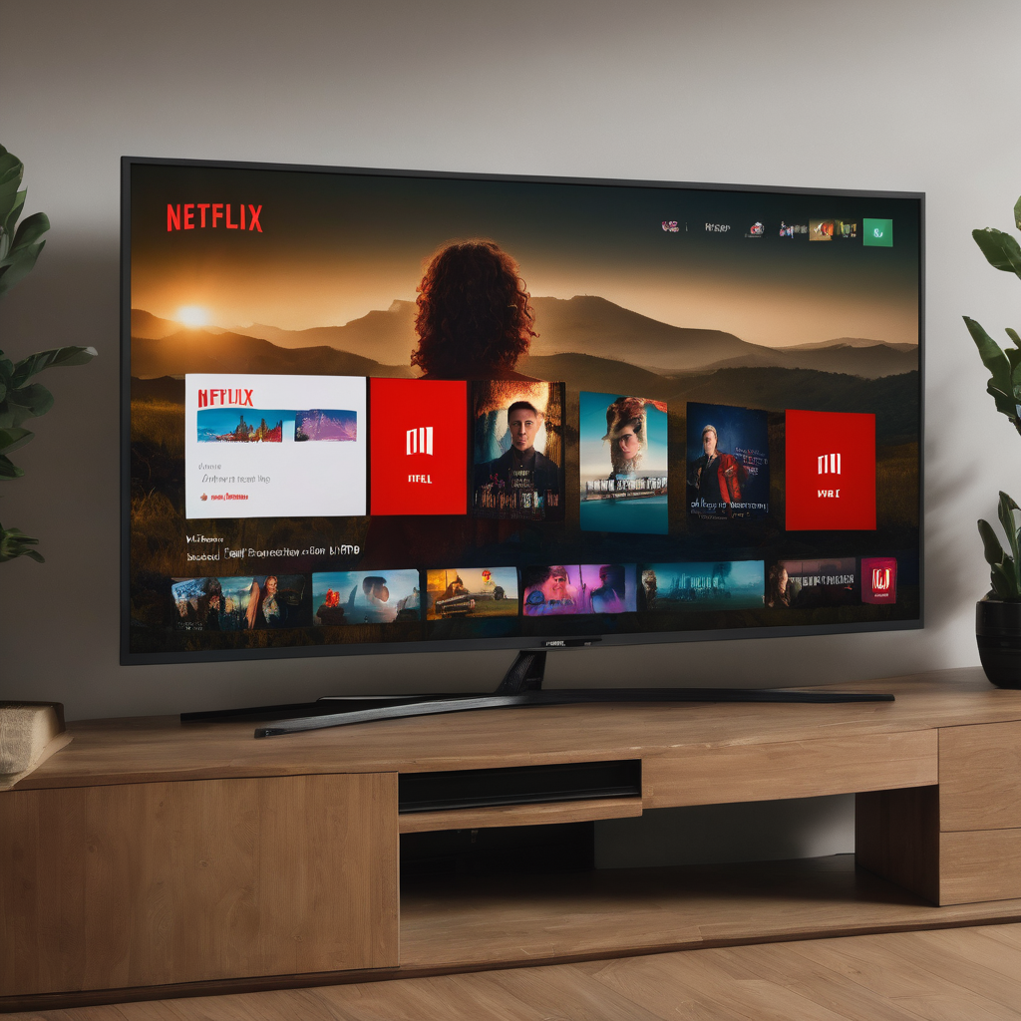
HARDWARE REQUIREMENTS
Monitor Type : Any modern monitor with a minimum resolution of 1280x800.
Processor : Intel dual-core processor and above.
RAM Size : 4 GB or more .
Clock Speed : 2.0 GHz or higher.
Hard Disk Capacity : 256 GB or more.

Slide 6
SOFTWARE REQUIREMENTS
Operating System : Windows 10, macOS, Linux.
Code Editor : Visual Studio Code or your preferred code editor.
Node.js : Install Node.js with npm for managing dependencies and running JavaScript.
ReactJS : Create your Netflix Clone project using ReactJS, a powerful JavaScript library for building user interfaces.
Database : Use Firebase, MySQL, or any preferred database system for storing data.
Web Browser : Google Chrome, Microsoft Edge, Mozilla Firefox.
Git : Consider using Git for version control and collaboration.

Slide 7
PROJECT DESCRIPTION
Module 1 : User Authentication
Foundation of the Netflix Clone project.
Allows users to create accounts securely.
Provides secure login access for personalized features.
Implements password security and authentication protocols.
Utilizes Firebase database for secure storage of login information.

Slide 8
Module 2: Netflix Page
Central hub of the Netflix Clone project.
Offers a dynamic homepage with featured content.
Organizes content into categories for easy browsing.
Enables seamless video streaming for a rich viewing experience.
Module 3: Video APIs
Integrates external video APIs to expand our content library.
Accesses a variety of movies and series data, including posters, and trailers.
Enhances the Netflix Clone project by offering a wide selection of content from different sources.
Ensures a diverse and engaging viewing experience for users.

Slide 9
Module 4: User Management
Allows users to view their username.
Provides a straightforward way for users to sign out from their accounts.
Ensures easy and secure management of user details and account access.
Module 5: Firebase Database
Centralizes user data storage, facilitating secure access and management.
Real-time synchronization of user-related data.
Efficiently structures and secures data while ensuring data consistency.
A critical component for maintaining user profiles in real-time.

Slide 10
CONCLUSION
Our Netflix Clone project has brought a seamless streaming experience to life, driven by React and Firebase. From user authentication to video APIs, it's a user-centric journey.
With centralized user data storage, we've ensured efficiency. As we conclude, we're excited about the future, embracing potential enhancements and continued excellence.
This project showcases the power of innovation and technology to enrich lives, and we're grateful for your support on this adventure.
The future holds more, and we can't wait to see where the Netflix Clone project goes. Thank you for being a part of this journey.

Slide 11
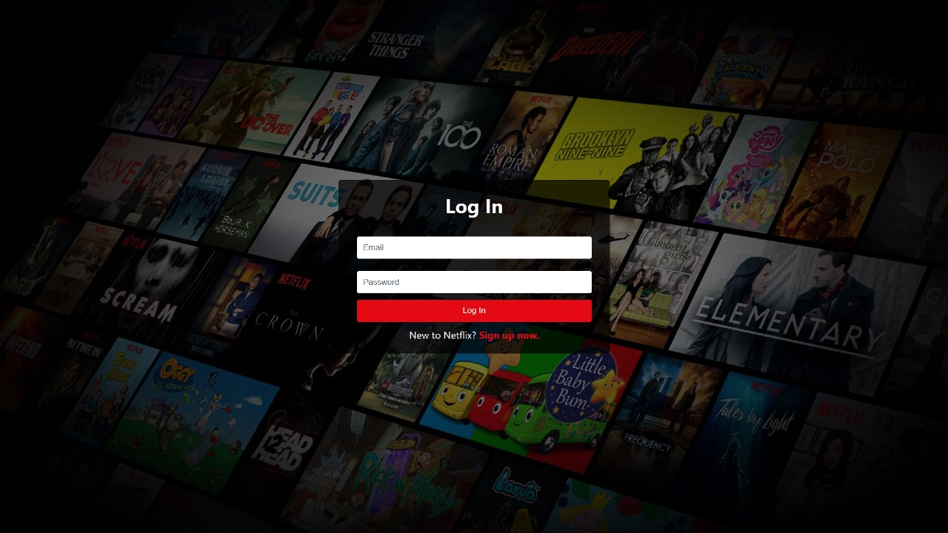
SCREENSHOTS

Slide 12
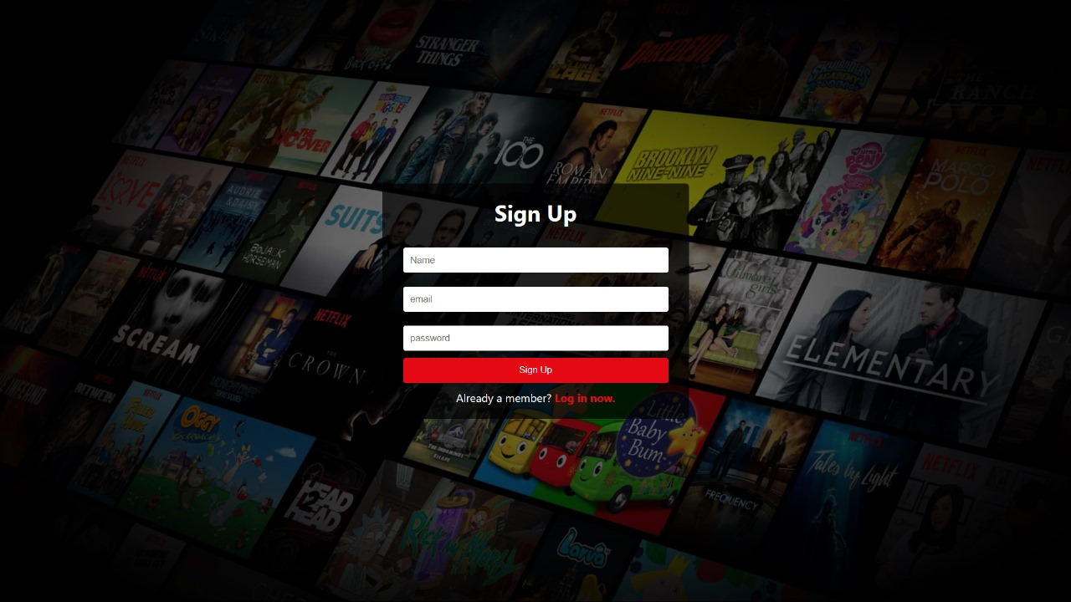

Slide 13
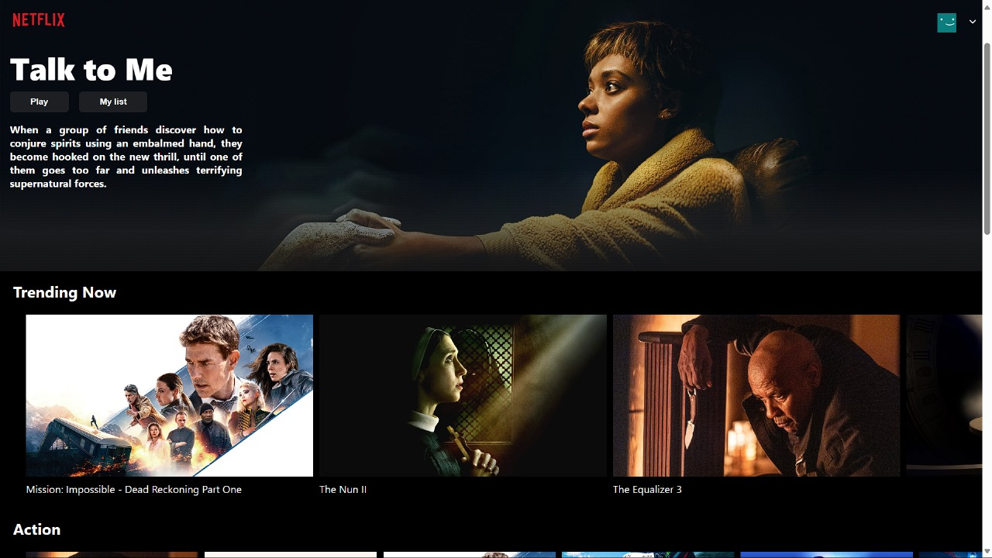

Slide 14
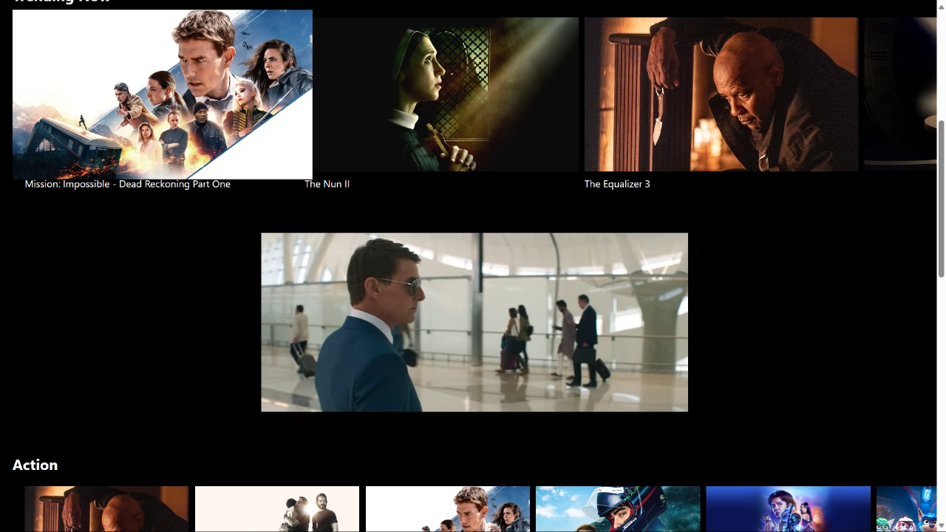

Slide 15
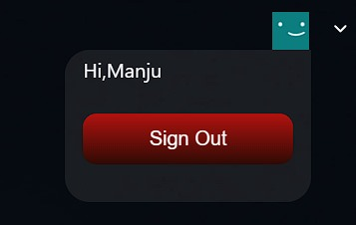

Slide 16
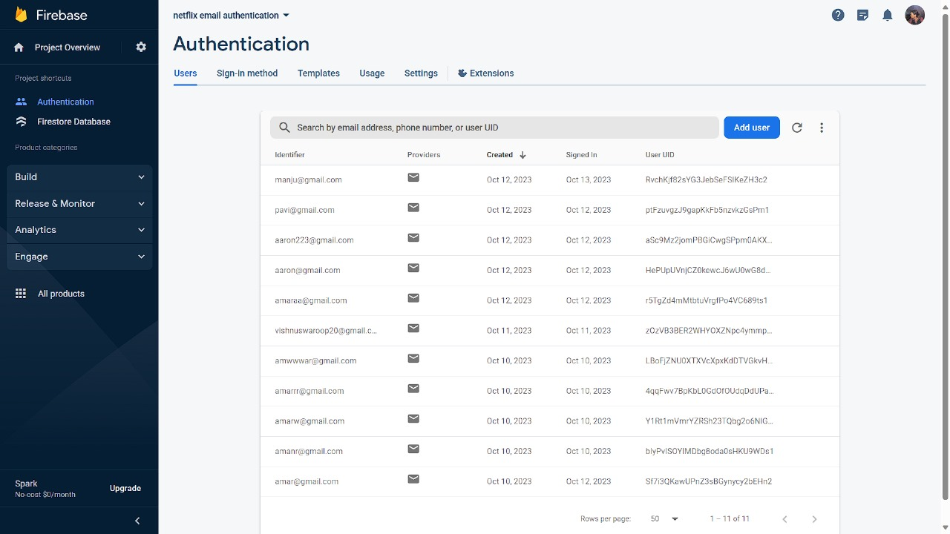

Slide 17
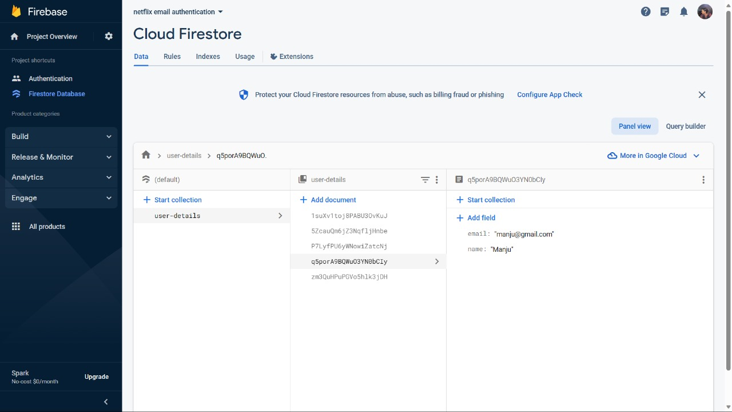

Slide 18
Thanks!

